Slide 1
PGVCL Training
Day-7

Slide 2
Flutter Training for PGVCL Department
Day 7 : State Management

Slide 3
Overview
Topics We’ll Be Covering For Today
Theory
Overview of state management techniques
Using BLOC.
Advantages and use cases of the chosen method.
Practical
Implement state management in a Todo app
Assignment
Extend the Todo app to include persistent state (e.g., saving tasks locally).

Slide 4
Objectives
Understand the importance of state management in Flutter apps.
Learn about popular state management technique: BLoC
Implement state management in a real-world application.
Learn how to extend app functionality with persistent state.

Slide 5
What Is State Management?
Definition: State management is the process of managing the data flow and state of an application efficiently, ensuring that the UI updates when the underlying data changes.
Types of State:
Ephemeral State: Temporary state (e.g., current tab, form field values).
App State: Persistent state (e.g., user login, fetched data).

Slide 6
Why Is State Management Important?
Simplifies Complex UI Interactions: Handles dynamic UI changes.
Improves Maintainability: Makes the codebase scalable and organized.
Optimizes Performance: Prevents unnecessary widget rebuilds.
Enhances Collaboration: Easier for teams to work on modular components.

Slide 7
Popular State Management Techniques
Riverpod:
A provider-based solution with enhanced simplicity and flexibility.
Advantages: Compile-time safety, improved performance, and simplicity.
BLoC (Business Logic Component):
Relies on Streams and Events to manage state.
Advantages: Strong separation of UI and business logic, reactive programming style.

Slide 8
Redux:
A predictable state container inspired by the Redux library for JavaScript.
Advantages: Centralized state management, debugging ease with tools like Redux DevTools.

Slide 9
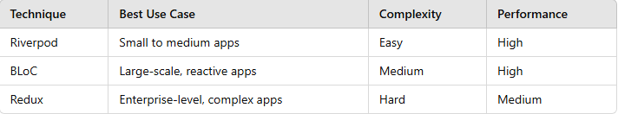
Choosing the Right State Management
Factors to Consider:
App complexity.
Developer experience and familiarity.
Scalability and performance requirements.

Slide 10
Practical: Todo App with State Management
Objective: Build a simple Todo app with the chosen state management technique.
Features:
Add, update, and delete tasks.
Toggle task completion status.

Slide 11
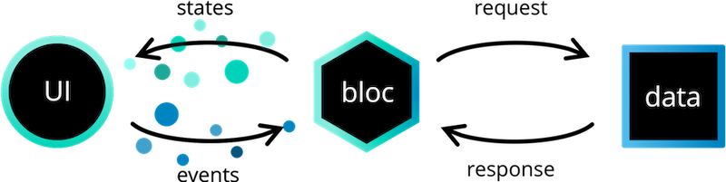

Slide 12
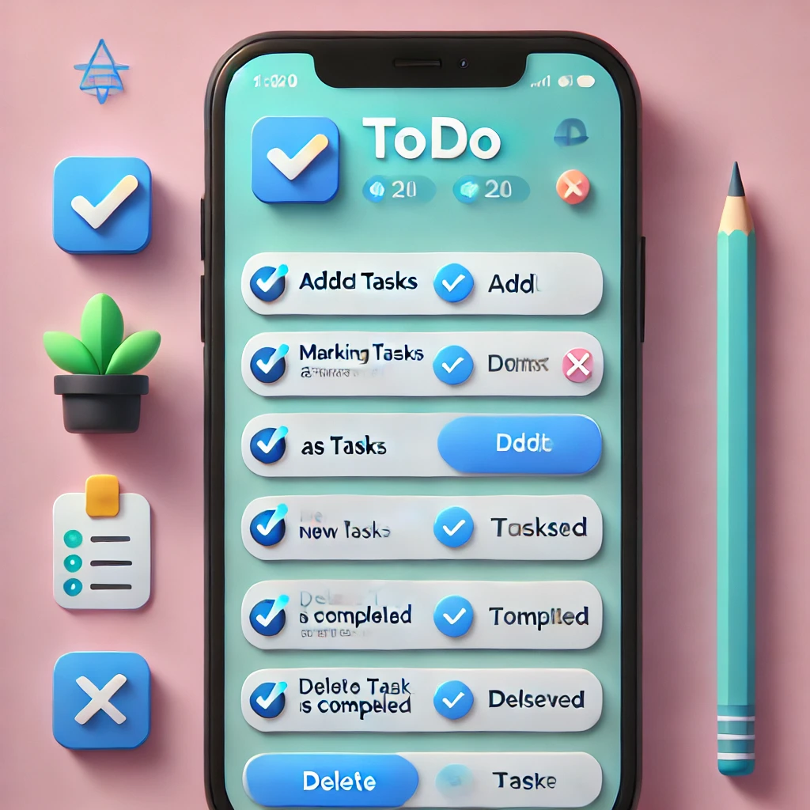

Slide 13
Practical Example
Link
Assignment Example
Create a basic UI with 3 Stateless Widgets and 2 Stateful Widgets

